Slide 1
Seminar/ Conference Presentation
Important Skills – Argumentation & Critical Thinking

Slide 2
Seminar v/s Conference
A conference is a formal meeting where people congregate to discuss a specific area of common interest while a seminar is an educational forum where members meet to acquire knowledge about a particular area.
Seminars take short period because they focus on a specific area while conferences may last for an extended duration since members discuss and air their opinion concerning the subject matter.
There is active participation in a conference where all the participants are required to give their feelings and opinions about a specific aspect while seminars offer limited involvement because participants receive directions from an expert.

Slide 3


Seminar v/s Conference………………contd.
A seminar takes an academic forum where participants acquire skills and knowledge and are given a certificate while conferences take a consultative view for discussion and members are not given a certificate.
Other differences between conferences and seminars include the purpose of the meeting and formality among others.

Slide 4
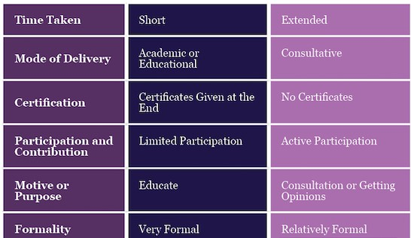
Criteria | Seminar | Conference

Slide 5
Presentation for Seminar/ Conference
Focus on Content.
An original idea.
Requires extensive research.
Proper collection and analysis of data.
Organising content.
Choose an appropriate style.
An emphatic start.
An impressive conclusion
Strategies
Audience & Locale
Use of Audio-Visual aids
Use of Non-verbal attributes
Use of important Skills
Critical Thinking
Argumentation

Slide 6
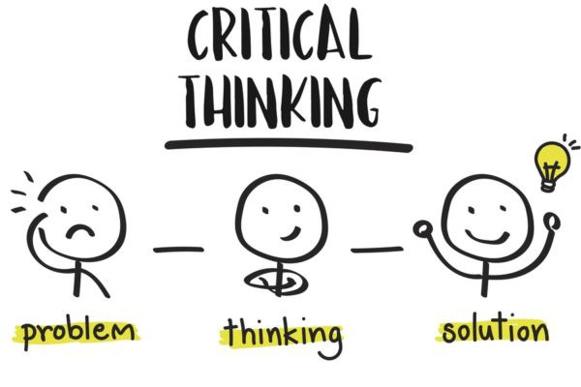

Slide 7
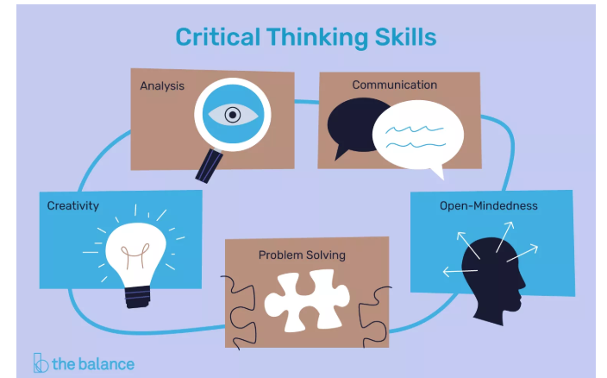
Critical Thinking
Critical thinking refers to the ability to analyze information objectively and make a reasoned judgment.
It involves the evaluation of sources, such as data, facts, observable phenomena, and research findings.

Slide 8
Top Critical Thinking Skills
Analysis
Part of critical thinking is the ability to carefully examine something, whether it is a problem, a set of data, or a text.
People with analytical skills can examine information, understand what it means, and properly explain to others the implications of that information.
Communication
Ability to communicate with others and share ideas effectively.
Need to work with others and communicate effectively to figure out solutions to complex problems.

Slide 9
Top Critical Thinking Skills…….contd.
Creativity
Critical thinking often involves creativity and innovation.
To spot patterns in the information or come up with a solution that no one else has thought of before.
All of this involves a creative eye that can take a different approach from all other approaches.
Open-Mindedness
Put aside any assumptions or judgments and merely analyze the information you receive.
Need to be objective; evaluating ideas without bias.

Slide 10
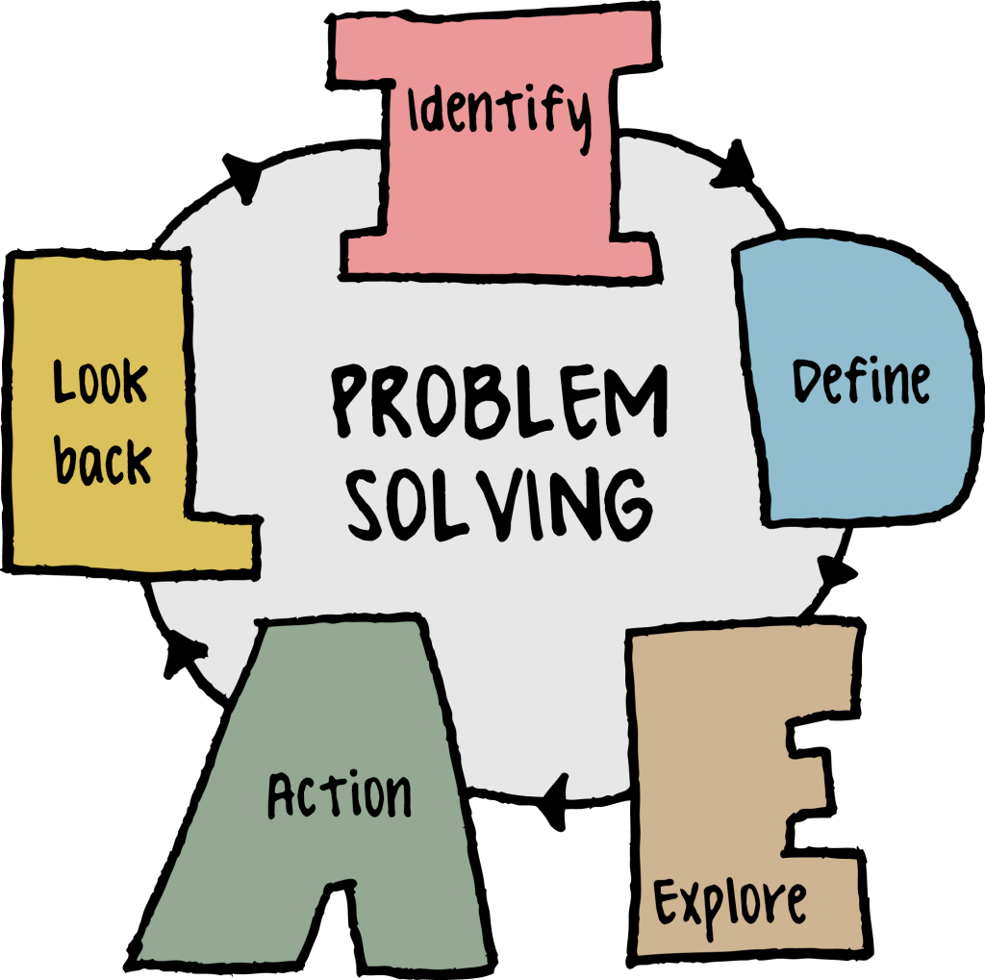
Top Critical Thinking Skills…….contd.
Problem Solving
Involves analyzing a problem, generating and implementing a solution, and assessing the success of the plan.
Employers don’t simply want employees who can think about information critically. They also need to be able to come up with practical solutions.

Slide 11
More Critical Thinking Skills
Inductive Reasoning
Deductive Reasoning
Compliance
Adaptability
Emotional Intelligence
Brainstorming
Integration
Strategic Planning
Case Analysis
Diagnostics
SWOT Analysis
Business Intelligence
Quantitative Data Management
Qualitative Data Management
Accuracy
Risk Management
Statistics

Slide 12
7 Ways to Think More Critically
1. Ask Basic Questions
Sometimes an explanation becomes so complex that the original question get lost.
To avoid this, continually go back to the basic questions you asked when you set out to solve the problem.
2. Question Basic Assumptions
Some of the greatest innovators in human history were those who simply looked up for a moment and wondered if one of everyone’s general assumptions was wrong.

Slide 13
7 Ways to Think More Critically……..contd.
3. Be Aware of Your Mental Processes
Human thought is amazing, but the speed and automation with which it happens can be a disadvantage when we’re trying to think critically.
A critical thinker is aware of their cognitive biases and personal prejudices and how they influence seemingly “objective” decisions and solutions.
4. Try Reversing Things
A great way to get “unstuck” on a hard problem is to try reversing things. It may seem obvious that X causes Y, but what if Y caused X?
The “chicken and egg problem” a classic example of this.

Slide 14
7 Ways to Think More Critically……..contd.
5. Evaluate the Existing Evidence
When you’re trying to solve a problem, it’s always helpful to look at other work that has been done in the same area.
It’s important, however, to evaluate this information critically, or else you can easily reach the wrong conclusion.
6. Remember to Think for Yourself
Don’t get so bogged down in research and reading that you forget to think for yourself–sometimes this can be your most powerful tool.

Slide 15
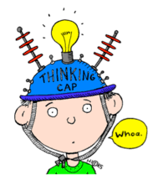
7 Ways to Think More Critically……..contd.
7. Understand That No One Thinks Critically 100% of the Time
You can’t think critically all the time, and that’s okay.
Critical thinking is a tool that you should deploy when you need to make important decisions or solve difficult problems, but you don’t need to think critically about everything.

Slide 16

Importance of Critical Thinking
Some professions require it
Decision-making improves
Critical thinkers are happier
Being well-informed is a bonus
It encourages self-reflection and improves relations
It bolsters the knowledge economy; Well informed

Slide 17
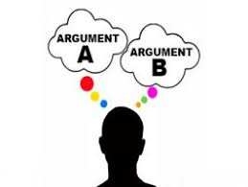
Argumentation Skills

Slide 18
Argumentation Skills
Argumentation is the thought process used to develop and present arguments.
It is closely related to critical thinking and reasoning.
An essential 21st century cognitive skills.
The term argument refers to "a reasoned attempt to convince the audience to accept a particular point of view about a debatable topic.“
“An argument is constituted by two or more explicit and/or implicit claims, one or more of which supports or provides evidence for the truth or merit of another claim, the conclusion.” (T. Edward Damer)

Slide 19
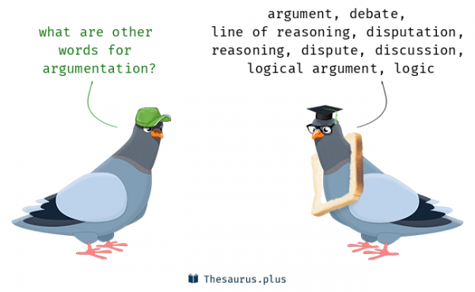
Characteristics
An argument consists of a conclusion and one or more premises, or claims.
Not irrational
Does not depend strictly on passion or emotion
Represents a "reasoned attempt"
Based on careful thinking and planning
Appeal is to the mind, the intellect of the
audience.

Slide 20
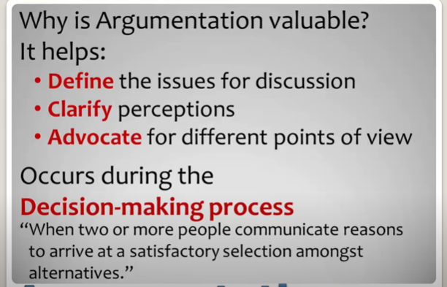
Importance
Formality of an Argument varies based upon the formality of a situation.
Home - Informal
Office –Formal
Courtroom- Highly Formal

Slide 21
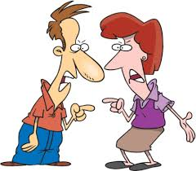
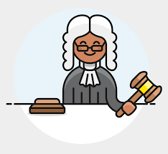
Types of Argument
General –
Informal
No special skill is required
But should be factual & reasonable
Ex – Argument with a friend or a family member
Specialised
Usually formal
Requires knowledge of rules.
Ex- Argument as a part of a Jury Member

Slide 22
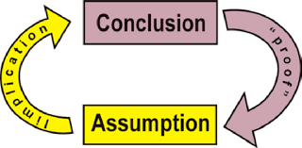
Principles
The five principles for developing a good argument:
Structure
Relevance
Acceptability
Sufficiency
Rebuttal

Slide 23
1. Structure
A good argument must meet the fundamental structural requirements of a well-formed argument.
To evaluate any argument for whether it violates the principle of Structure, ask the following questions:
Does the communication include at least one reason to support the conclusion as being true? If it doesn’t, then it’s not an argument — it’s merely an opinion.
Could any of the key premises be interpreted as making the same claim as the conclusion? If so, then it’s a “circular argument”. “Joe is nuts,” Gary says. “Why do you say that?” I ask. “Because he’s so crazy,” Gary replies. Since A, therefore A.
Do any of the premises contradict another premise, or does the conclusion contradict any of the premises?

Slide 24
2. Relevance
The reasons that a communicator provides as part of his or her argument must be relevant for the truth or merit of the conclusion.
To assess whether an argument violates the principle of Relevance, ask these two questions:
If the premise were true, does it make you more likely to believe that the conclusion is true? If yes, the premise is probably relevant. If no, then the premise is probably not relevant.
Even if the premise were true, should it be a consideration for accepting the truth of the conclusion? If no, then the premise is probably not relevant. “Jerry is over 6 ft. tall. So he must be good at basketball.” “Avatar is an artistic masterpiece. After all, it was the highest grossing film of the year.”

Slide 25
3. Acceptability
A premise should be acceptable to a mature, rational adult.
To assess whether an argument violates the principle of Acceptability, ask the following questions:
Is the premise provided one that a mature, rational adult would likely accept?
What evidence is provided as part of the claim, and does it conform to the standards of acceptability or the conditions of unacceptability?
Is the premise based on an unstated assumption that a mature, rational adult not be willing to accept?

Slide 26
4. Sufficiency
A communicator making an argument should provide reasons that are sufficient to justify the acceptance of his or her conclusion.
To evaluate whether an argument violates the principle of Sufficiency, ask the following questions:
Are the reasons provided enough to drive to the arguer’s conclusion?
Is the premise based on insufficient evidence or faulty causal analysis? Some premises provide evidence that is based on too small a sample or unrepresentative data. Or the evidence is based on the personal experience of the arguer, or of a small set of acquaintances that the arguer knows. The premise may be based on faulty causal analysis — assuming A caused B, even though the two events were unrelated.
Is some key or crucial evidence missing that must be provided in order to accept the argument?

Slide 27
5. Rebuttal
A good argument includes an effective rebuttal to all anticipated serious criticisms of the argument.
To assess whether an argument fails to meet the Rebuttal principle, ask the following questions:
Does the argument provided address the strongest counterarguments effectively?
Does the arguer anticipate and address serious weaknesses in the argument?
Does the argument show why alternative positions are flawed?

Slide 28
Suggestions for Stronger Argument
Structure: Explicitly call out your conclusion and the supporting reasons, so that they are easy to recognize and follow.
Make explicit any key assumptions that you’re using.
Ensure that your premises
(1) do not contradict each other or the conclusion
(2) do not assume the truth of the conclusion.
Relevance: Ensure that all materials you’re presenting as part of your argument are relevant. Don’t weaken your argument by including irrelevant premises.

Slide 29
Suggestions for Stronger Argument…..contd.
Acceptability: Whenever possible, substitute less controversial claims for more controversial ones.
Soften, if possible, any absolute claims to make them more acceptable. (e.g. “most politicians” instead of “all politicians”)
Don’t use highly questionable evidence or assumptions.
Sufficiency: Continue adding relevant premises if they contribute to the number and weight of the reasons that drive to your conclusion.
Put yourself in your audience’s place, and ask if the reasons are sufficient to accept your conclusion.

Slide 30
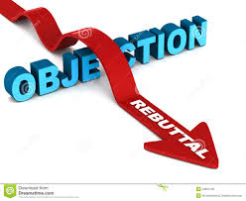
Suggestions for Stronger Argument…contd.
Rebuttal: Be as exhaustive as necessary in your rebuttal.
Some arguments may need to rebut a single criticism, but more controversial or divisive issues may require multiple rebuttals.
Declare up front what the weakest parts of your argument are and proactively address them to blunt the force of your opponent’s counterarguments.

Slide 31

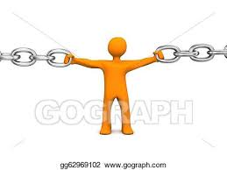
Devices of Argumentation
Analysis – Analyse the argument.
Check for evidences, conclusions & assumptions.
Cohesion – A series of logical reasons to support an idea.
Start by showing research and giving context for the issue.
Tools of Cohesion –
Use of pronouns
Repetition of key words or phrases
Use of transitional tags
Use of parallel grammatical structure

Slide 32
Devices of Argumentation……..contd.
Emphasis –
Emphasize on key idea.
Repeat key points throughout the premises to establish connect.
Critical Thinking –
Analyse facts to form judgement.
Rational, sceptical, unbiased analysis of factual evidence.
Nuances/ Organisation of Content -
Introduction, Body & Close

Slide 33
THANKS

